Slide 1


MAJESTIC-CODERS
SIH’20
Problem St. No.-> DR113
by Govt. Of GOA
Stray Cattle Challenge

Slide 2
Problem Statement
Stray Cattle Challenge
Checking the menace of stray cattle in State of Goa by involving Municipalities, Panchayats, Animal Husbandry, NGO and Civic Forum. Stray Cattle not only bad to traffic congestion but also causes health hazard to the cattle. ISSUES (a) Fundamentally there is disconnection between civil agencies, people and elected representatives. (b) The aim is to build mobile based dynamic reporting system which will facilitate into flow of information among all concerned stakeholders. (c) The aim is to provide better Governance by more involvement of public.

Slide 3
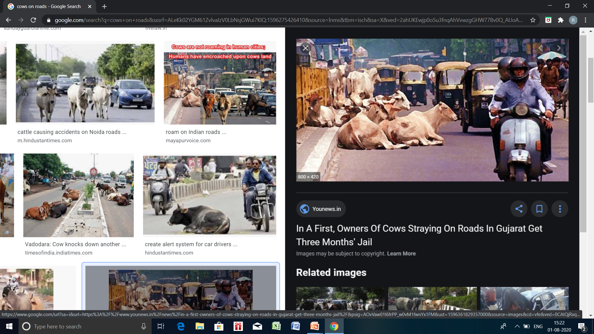
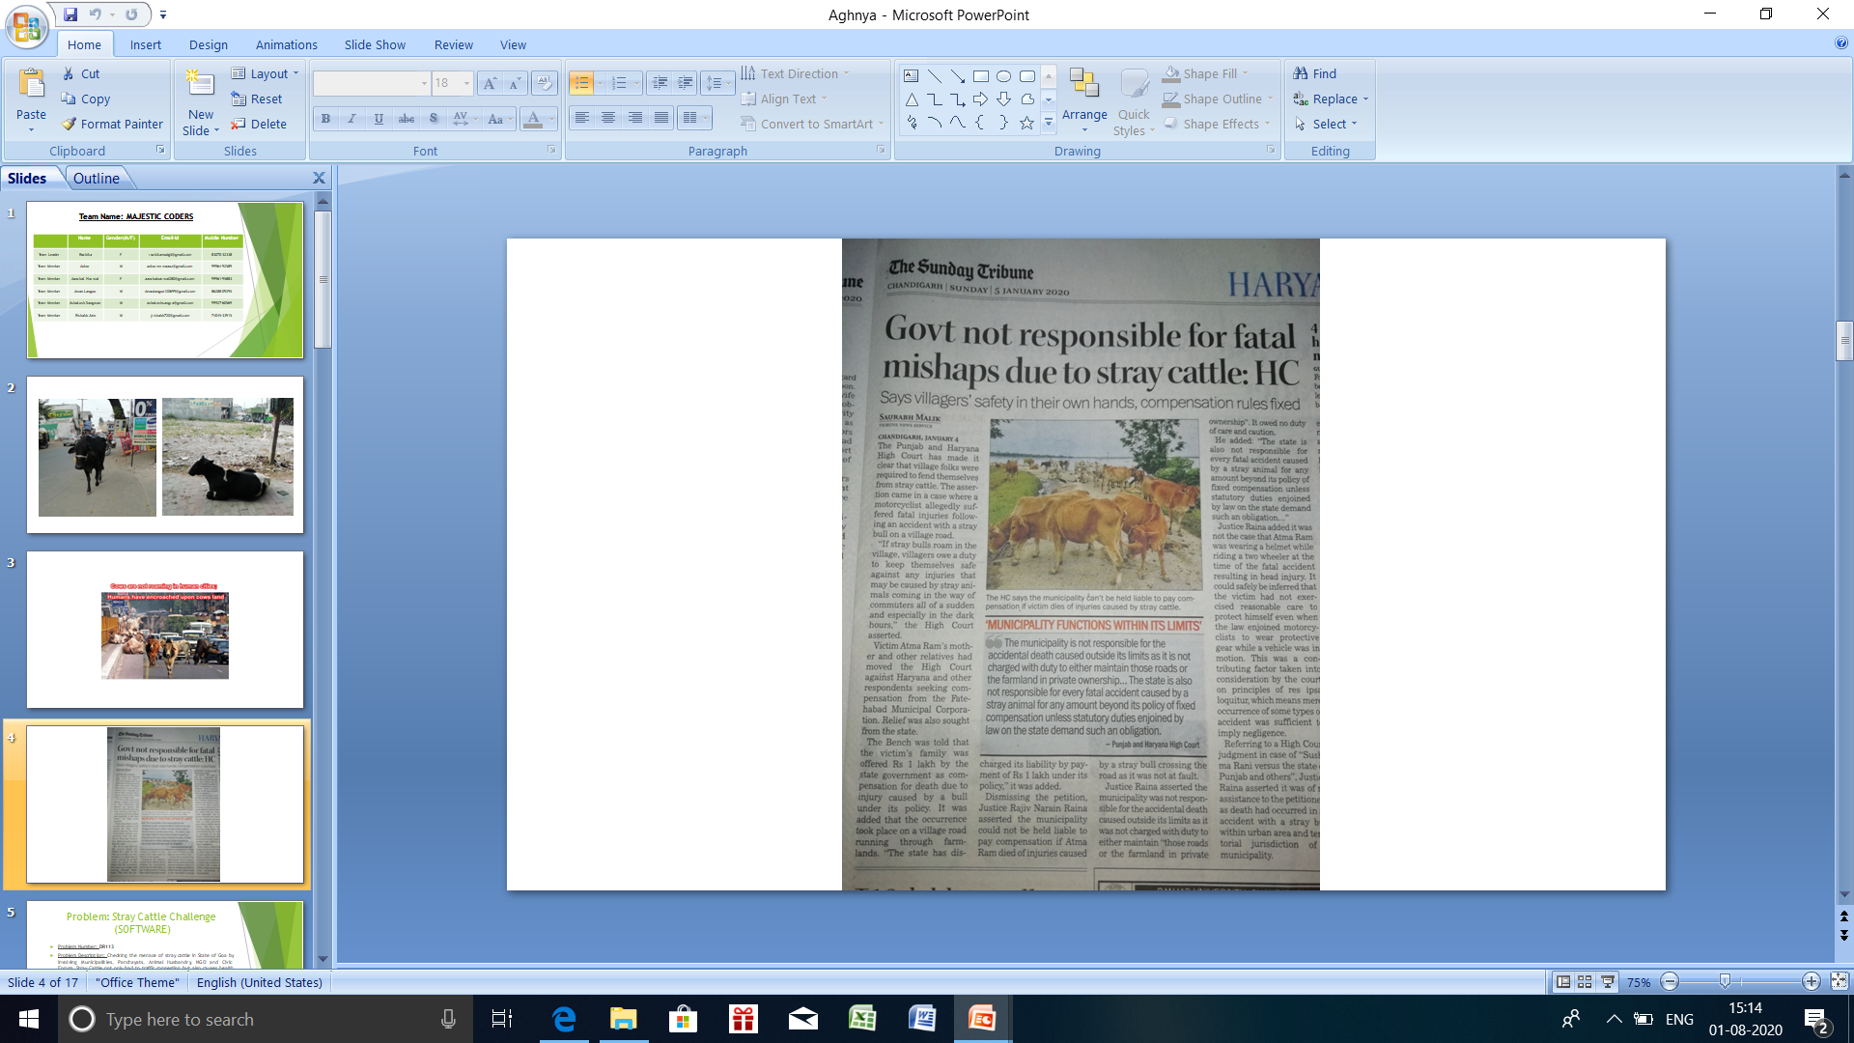
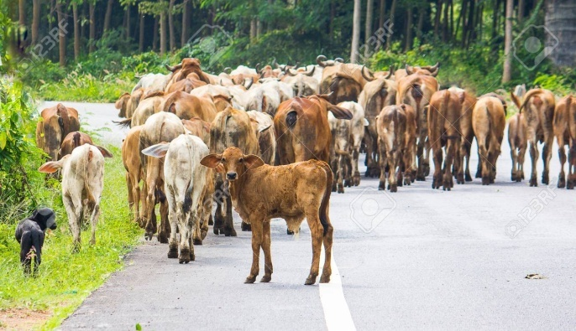
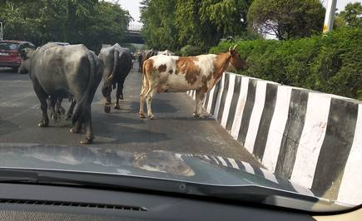
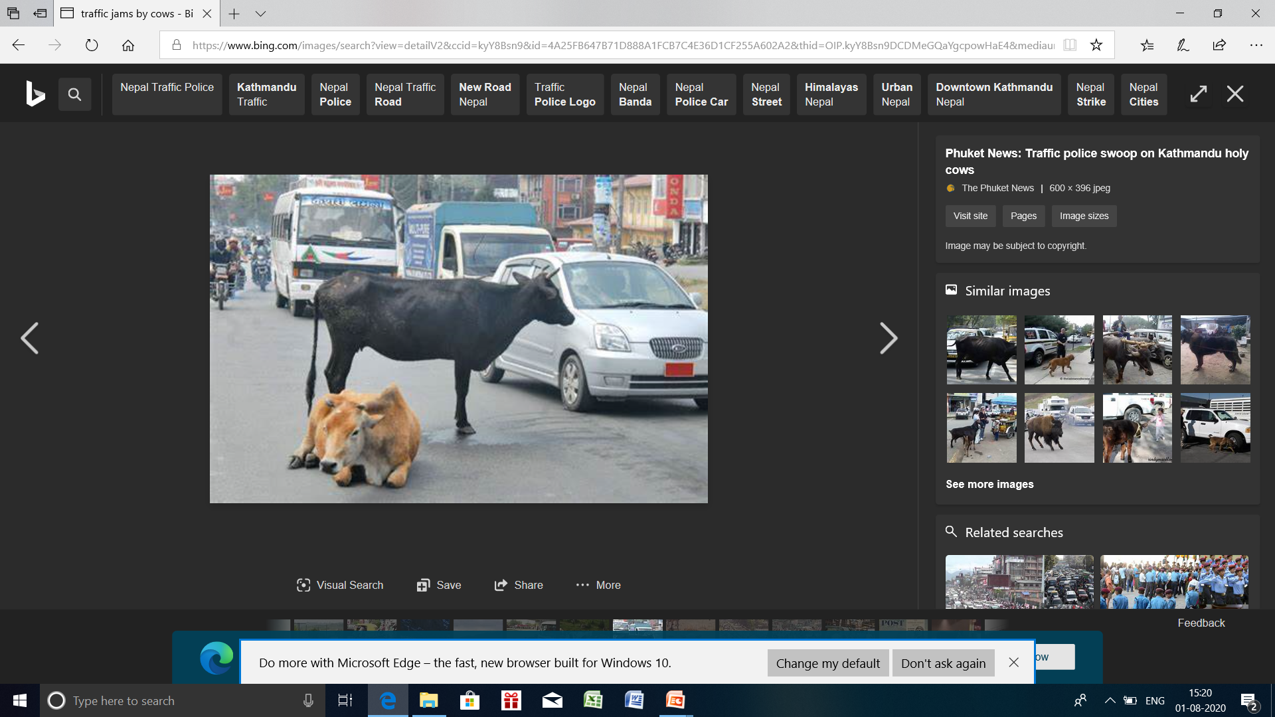
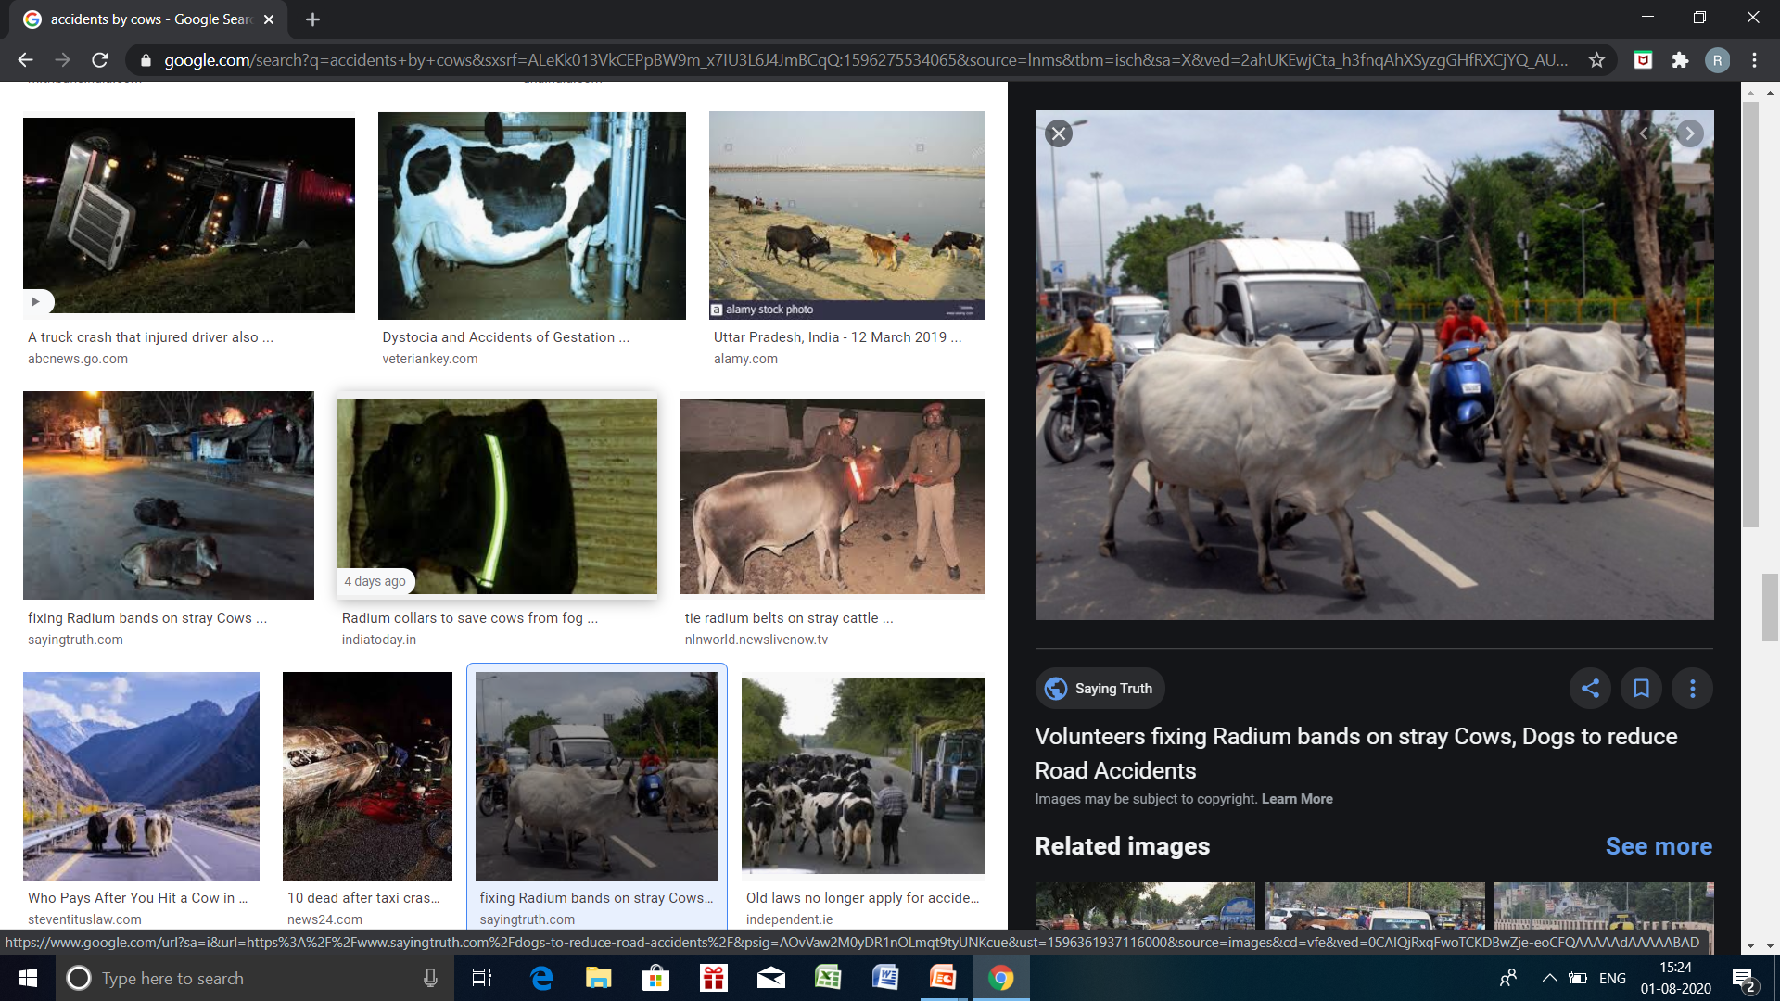
COWS RULE THE ROAD IN INDIA
COWS RULE THE ROAD IN INDIA
Who is responsible?????
TRAFFIC-JAMS ACCIDENTS

Slide 4
Solution Description:
As nowadays, street cameras are present mostly on every road. So, with the use of that
And AI we will detect the presence of cattle on roads and will show them on map.
If a user watches a cow or traffic jam or accidents caused by cows then they can report it by using our app. App has a specially designed AI camera which will predict the presence of cow in the image and will report a complaint with the latest timestamps and location of user. This feature is for effortless reporting.User app also have one map which will show the cows present in nearby area.
Special application for authorities so that they can receive all complaints from user and
the reports from cctv camera.

Slide 5
our solution
AGHNYA
Not to be killed

Slide 6
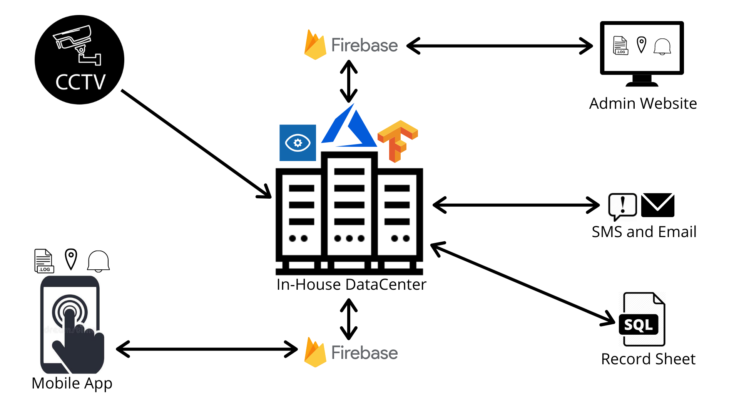
Model Pipeline

Slide 7
In-House Data Centre:- AI Model to detect the presence of cattle
Input sources: CCTV Camera stream and reported images by user
As AI is the future, so with the help of that we had made a model which will detect
The presence of cattle in videos and images.
Training Images: Images from Streets, Internets, Video Streams, etc were used for training the Cow Detection Model

Slide 8
MAP for showing Live Locations in both Admin and user APP
We have used maps for showing the live locations so that the user can take easy idea about the presence of cattle on roads so, that accidents and jams can be easily avoided.
Basically the location is of the GPS location of CCTV cameras and the GPS location of the mobile of the user where the cattle is detected.
Although there is slight difference in the information that is to be shown on the common user and admin.
Admin will also have a track of animal catching vans through the same map.

Slide 9
USER APP
App for the users where they can easily report complaints and get information about the status of cattle on roads.
The app is specially designed to bridge the gap between govt. Authorities and common people.
App has two main features :
1.Reporting through camera
2.Map showing live status of cattle on roads
The UI of the app is so easy that even an illiterate person can easily use this, as this
App only have icons very less text is used.
Effortless reporting of complaint, no need of filling large forms.
Technologies used:-
IONIC framework, TypeScript, Android

Slide 10
Website for Admin
To bridge the gap between common people and these authorities, this desktop app
Is for the admin so that they can easily receive the notifications of the locations of cattle.
The notification on the specific admin will go to the person who is more close to the requires Location.
The app for the admin is slightly different, he/she can track the location of the animal catching vans also.
Technologies used:
JavaScript, CSS, HTML, Firebase, Maps API

Slide 11
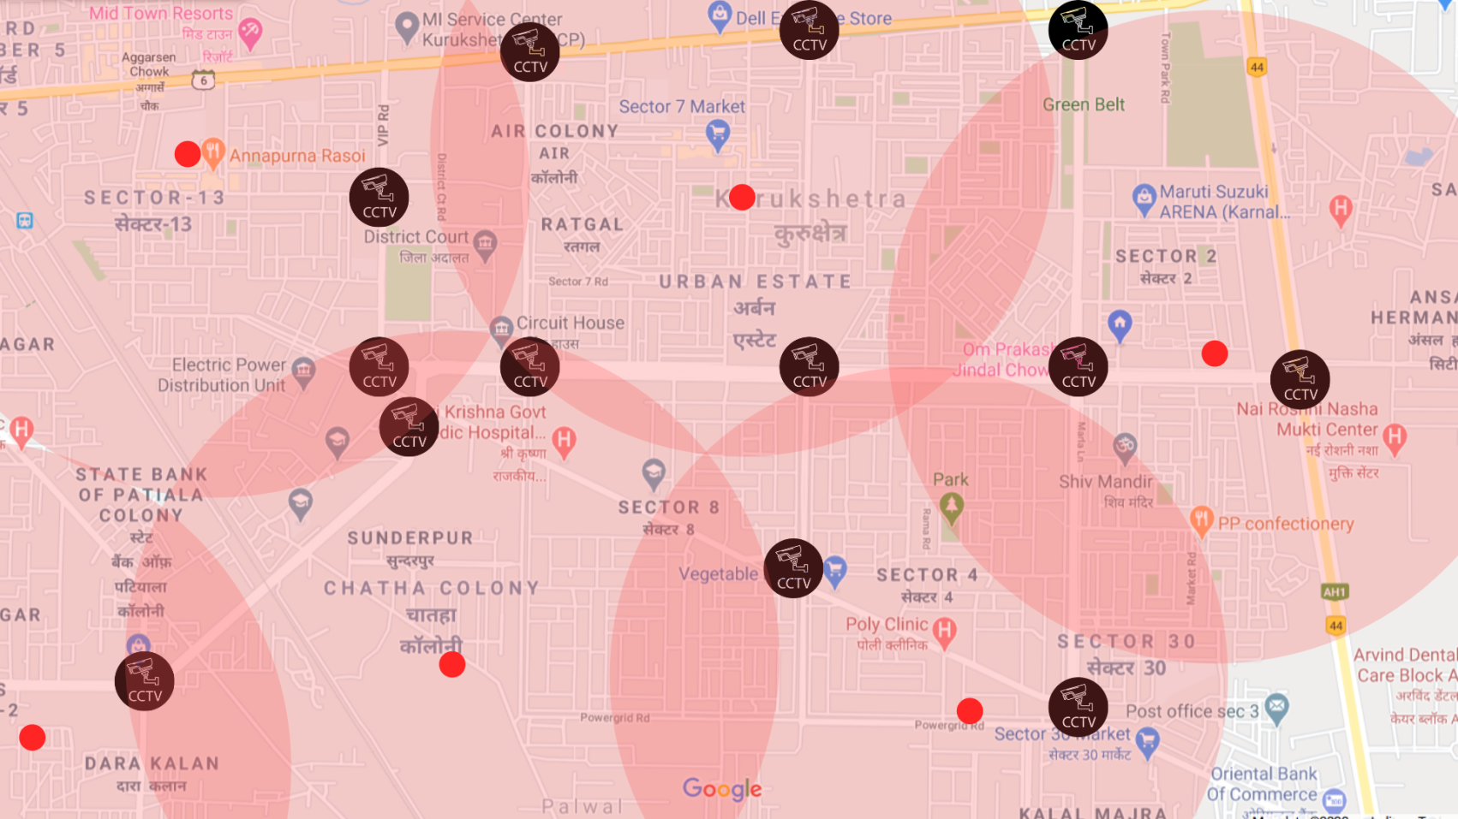
Planning Kurukshetra City Map

Slide 12
THANK YOU
Team: MAJESTIC-CODERS

